Slide 1

NLP: Recurrent Neural Network
Video 7: Advanced RNN Architectures

Slide 2
Advanced RNN Architectures
1
Multilayered RNN
2
Bidirectional RNN

Slide 3
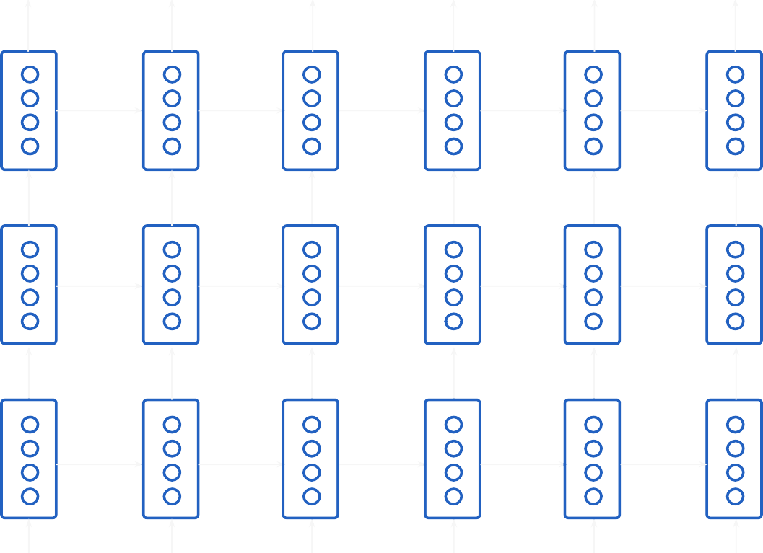
RNN With Multiple Layers
Hidden Layer 3
Hidden Layer 2
Hidden Layer 1

Slide 4
RNN With Multiple Layers
^{y}31 ^{y}32
…..
…..
…..
…..
^{h}31
^{h}32
Layer 3
^{y}21
^{y}22
^{h}21
^{h}22
Layer 2
^{y}11
^{y}12
^{h}11
^{h}12
Layer 1
x₁
game
…..
…..
…..
…..

Slide 5
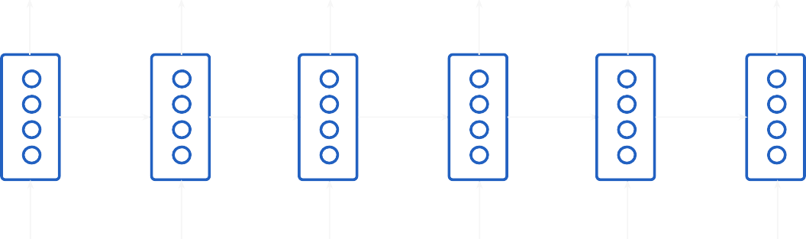
RNN With Multiple Layers
^{y}31 ^{y}32 ^{y}33 ^{y}34 ^{y}35 ^{y}36
^{h}31
^{h}32
Layer 3
^{y}21
^{y}22
^{y}23
^{y}24
^{y}25
^{y}26

Slide 6




Bidirectional RNN
y₁
y₂
y₃
y₄
h’₄ h’₃ h’₂ h’₁ h’₀
h₀ h₁ h₂ h₃ h₄
x₁
x₂
x₃
x₄

Slide 7

Unidirectional RNN
The bandage was wound around the wound
Noun

Slide 8
Bidirectional RNN
Verb
The bandage was wound around the wound
Noun

Slide 9
Bidirectional RNN
Concatenate the 2 hidden states obtained after forward and backward pass
y₁
y₂ y₃ y₄
h’₄ h’₃ h’₂ h’₁ h’₀
h₀ h₁ h₂ h₃ h₄
x₁
x₂
x₃
x₄

Slide 10
Bidirectional RNN
final
h₂ = [h₂ ; h’₃]
final
y₁
y₂
y₃
y₄
h₁ = [h₁ ; h’₄]
h’₄
h’₃
h’₂
h’₁
h’₀
h₀
h₁
h₂
h₃
h₄
x₁
x₂
x₃
x₄

Slide 11
Bidirectional RNN
y₁= A’ ( h₁ ^{final} * W_{y} + b_{y} )
y₂
y₃
y₄
h’₄
h’₃
h’₂
h’₁
h’₀
h₀
h₁
h₂
h₃
h₄
x₁
x₂
x₃
x₄

